Slide 1
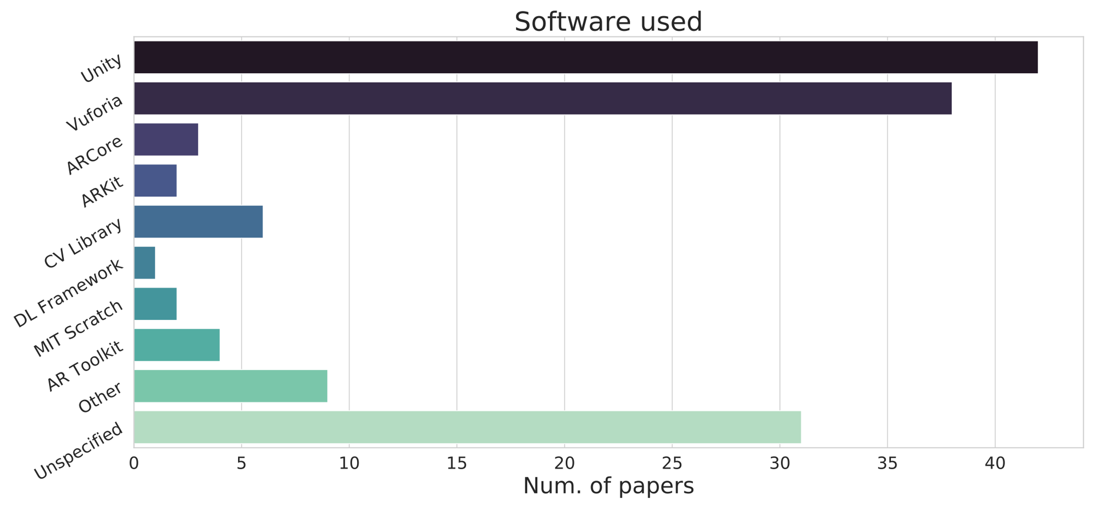
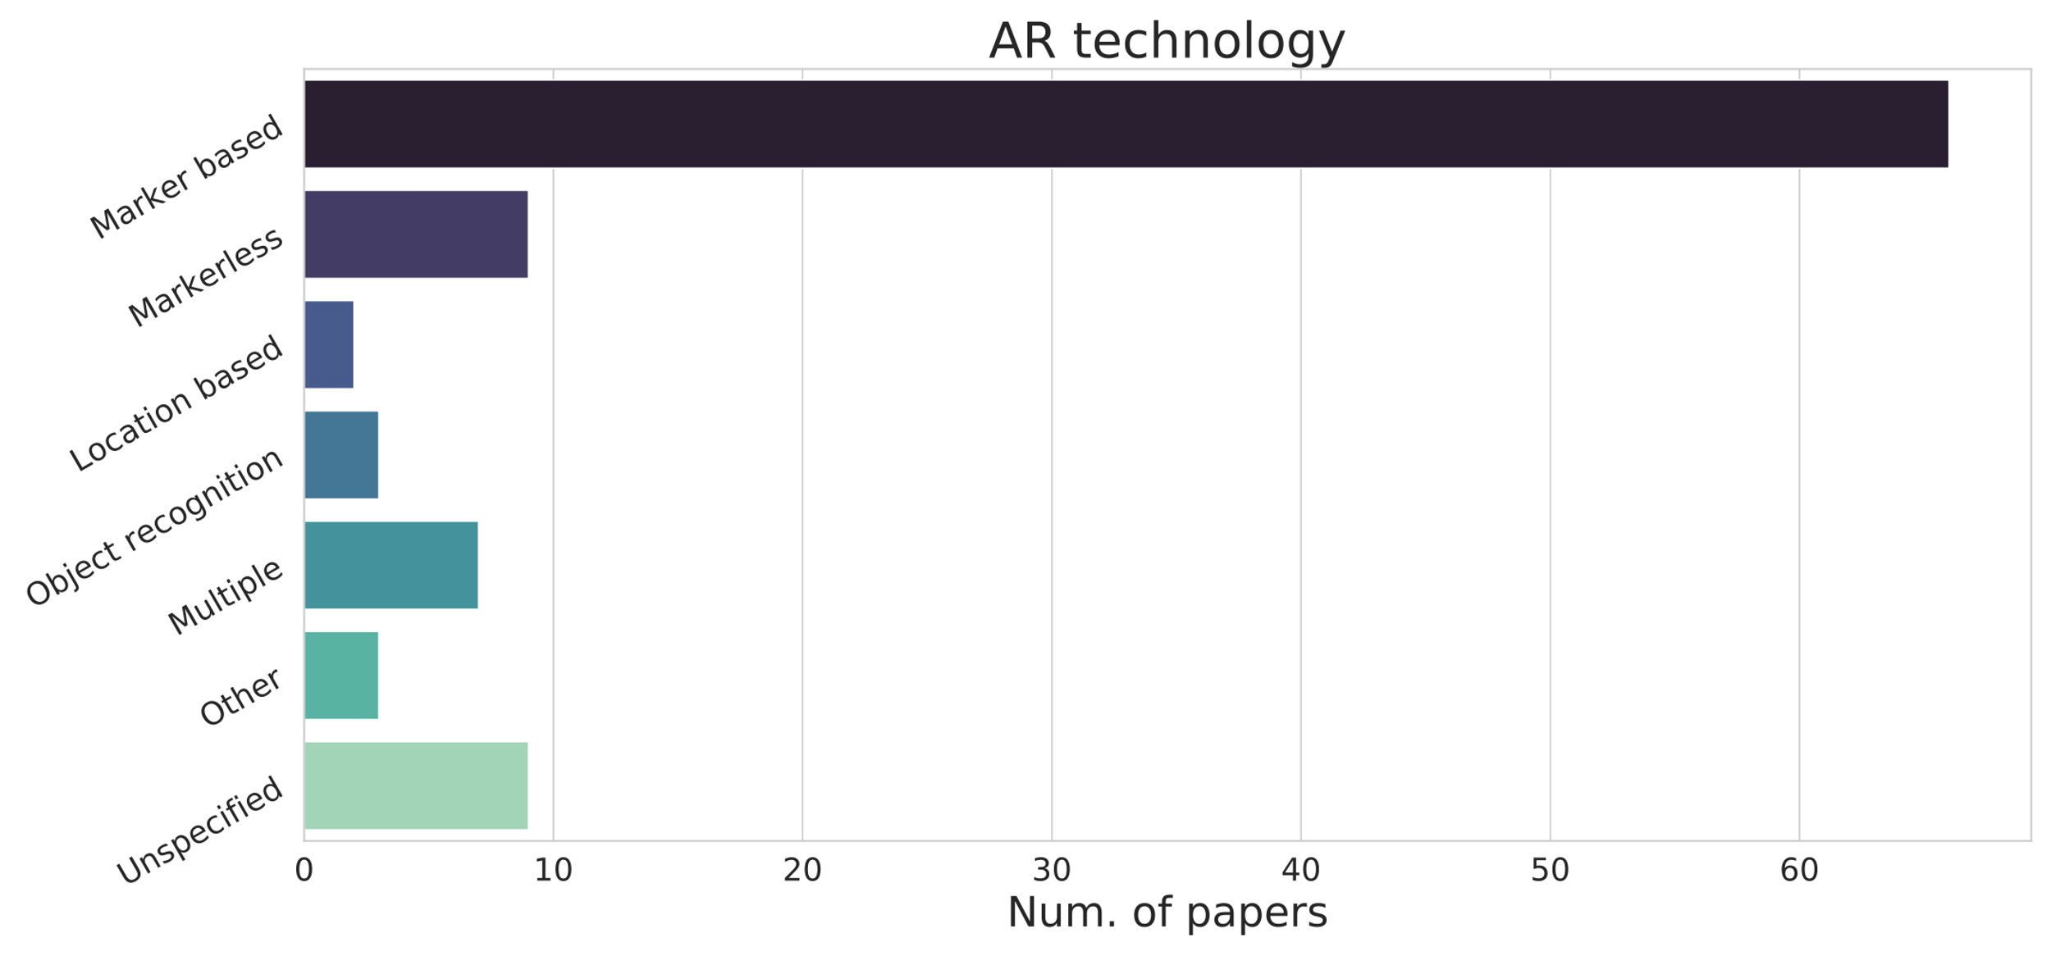
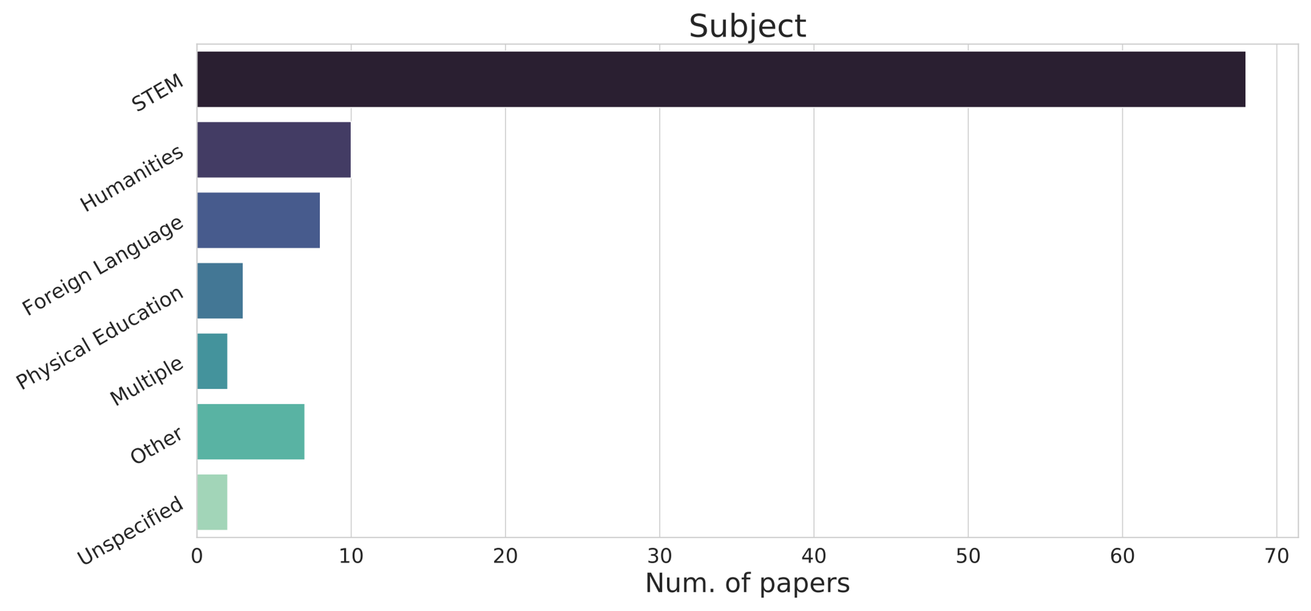
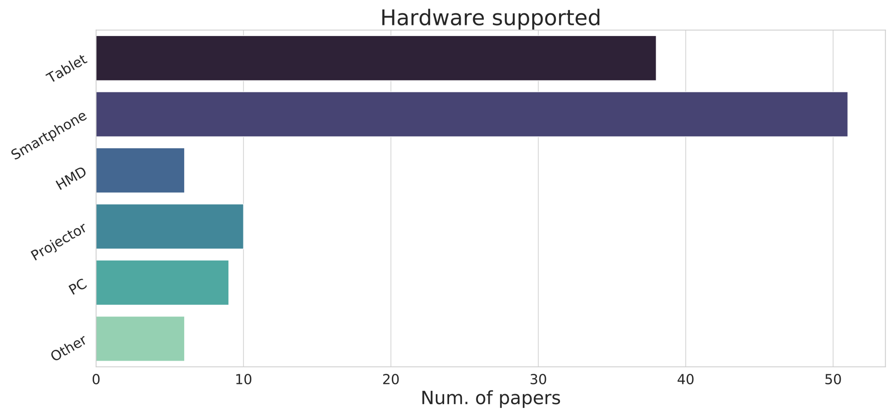

Overview
Pre & post tests
AR in Education
Effectiveness
Control group
Surveys
Basic
Interactivity
Collaborative
Object
Multi-user
Gamification
Behaviour
Augmented

